Slide 1

VMware Site Recovery Manager v8.4
Technical Review
v1.1
Ariel Sanchez
@arielsanchezmor

Slide 2

Agenda
Introduction
SRM Technical Overview
SRM Architectural Overview
How the product/solution fits with other VMware products or 3rd Party products/solutions

Slide 3
1.1 Introduction
A bit about me
A bit about VMware Tech Webcasts
https://twitter.com/TechVmw
https://github.com/VMware-Tech-Webcasts/info/blob/main/README.md
Our YouTube channel were this and all talks will be uploaded

Slide 4
1.2 Sources for this presentation
Sources:
Official Documentation https://docs.vmware.com/en/Site-Recovery-Manager/index.html
v8.4 Release Notes https://docs.vmware.com/en/Site-Recovery-Manager/8.4/rn/srm-releasenotes-8-4.html
Site Recover Manager Technical Overview https://core.vmware.com/resource/site-recovery-manager-technical-overview

Slide 5
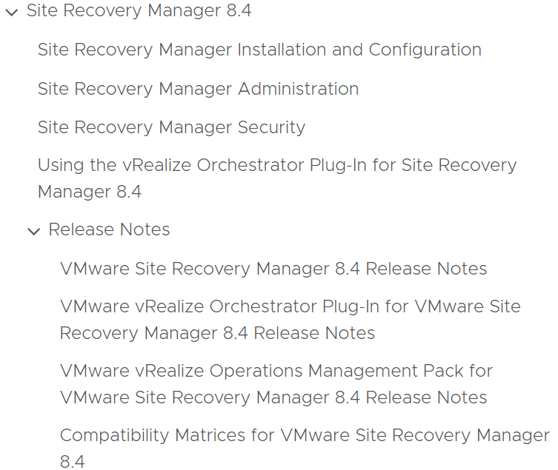
1.3 Documentation spans several documents

Slide 6
2.1 Technical Overview of SRM
VMware Site Recovery Manager is a business continuity and disaster recovery solution that helps you plan, test, and run the recovery of virtual machines between a protected vCenter Server site and a recovery vCenter Server site.
It is an extension to VMware vCenter™ that provides disaster recovery, site migration, and non-disruptive testing capabilities to VMware customers.

Slide 7
2.2 Technical Overview of SRM
Site Recovery Manager works in conjunction with various replication solutions to automate the process of migrating, recovering, testing, re-protecting, and failing-back virtual machine workloads.
Migration of protected VMs from one site to the other is controlled by a recovery plan that specifies the order in which virtual machines are shut down and started up. SRM enables the testing of recovery plans in a way that does not disrupt ongoing operations at either site. Multiple recovery plans can be configured to migrate applications groups or entire sites, providing control over what virtual machines are failed over and failed back.

Slide 8
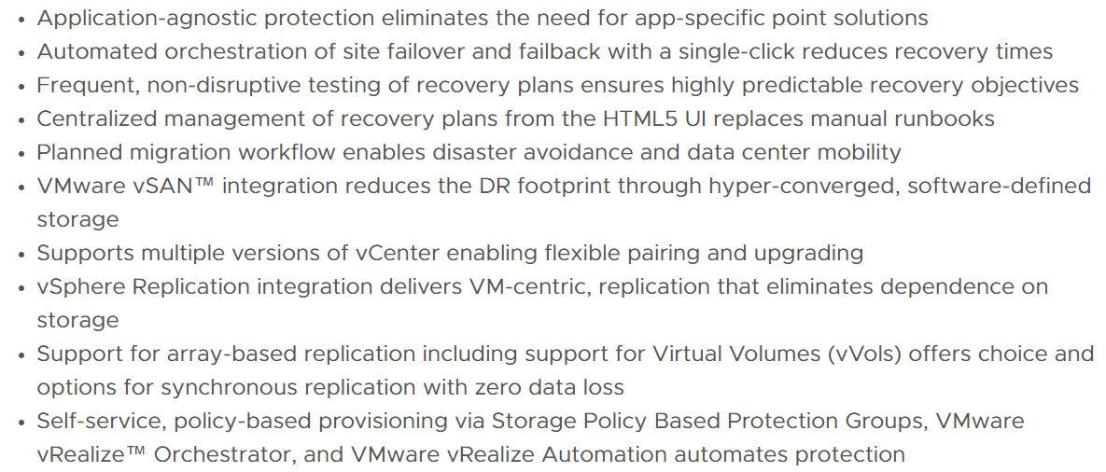
2.3 Features and benefits of SRM

Slide 9
2.4 Terminology for Disaster Recovery
Recovery time objective (RTO): Targeted amount of time a business process should be restored after a disaster or disruption in order to avoid unacceptable consequences associated with a break in business continuity.
Recovery point objective (RPO): Maximum age of files recovered from backup storage for normal operations to resume if a system goes offline as a result of a hardware, program, or communications failure.

Slide 10
2.5 Terminology for SRM
Consistency group: One or more LUNs or volumes that are replicated at the same time. When recovering items in a consistency group, all items are restored to the same point in time.
Datastore group: One or more datastores that are treated as a unit in Site Recovery Manager. A common example is a consistency group in an array replication solution.

Slide 11
2.6 Terminology for SRM (continued)
Protected site: Site that contains protected virtual machines.
Recovery site: Site where protected virtual machines are recovered in the event of a failover.
NOTE: It is possible for the same site to serve as a protected site and recovery site when replication is occurring in both directions and Site Recovery Manager is protecting virtual machines at both sites.

Slide 12
2.7 Terminology for SRM (continued)
Failover: Method of recovering applications and services to a secondary system when the primary system experiences a failure or disaster.
Failback: Restoring applications and services from a secondary system back to the primary system after a failover has occurred.
Reprotect: Specific to Site Recovery Manager, the process of reversing the direction of replication and enabling recovery plans for a failback event.

Slide 13
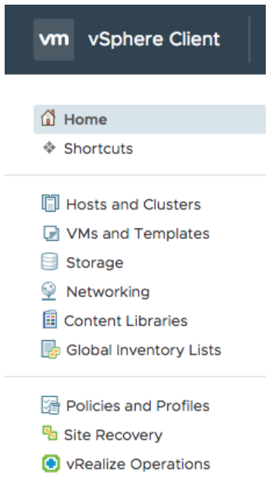
2.8 SRM User Interface
Site Recovery Manager is managed using an HTML5 based UI.
During the installation of Site Recovery Manager, a plugin labeled “Site Recovery Manager” is installed in the vSphere HTML5 UI or Web Client and an icon labeled “Site Recovery” is displayed.

Slide 14
2.9 Types of Recovery
There’s two main types of recovery from protected to recovery site:
Planned migration is the orderly migration of virtual machines from the protected site to the recovery site. Planned migration prevents data loss when migrating workloads in an orderly fashion. Both sites must be running and fully functional.
Disaster recovery does not require that both sites be up and running, and it can be initiated in the event of the protected site going offline unexpectedly. During a disaster recovery operation, failure of operations on the protected site is reported, but otherwise ignored.

Slide 15
2.10 SRM Use cases
Though the most obvious use case for Site Recovery Manager is disaster recovery from one site to another, it can handle different use cases and provide significant capability and flexibility to customers.
For all use cases and situations Site Recovery Manager supports non-disruptive testing of recovery plans in network and storage isolated environments.
This provides for the ability to test disaster recovery, disaster avoidance, or planned migrations as frequently as desired to ensure confidence in the configuration and operation of recovery plans.

Slide 16
2.11 Use case for Disaster Recovery
Disaster recovery or an unplanned failover is what Site Recovery Manager was specifically designed to accomplish.
This is the most critical but least frequently used use case for Site Recovery Manager. Unexpected site failures don’t happen often but when they do fast recovery is critical to business.
Site Recovery Manager can help in this situation by automating and orchestrating the recovery of critical business systems for partial or full site failures ensuring the fastest RTO.

Slide 17
2.12 Use case for Disaster Avoidance
Preventive failover can be anything from an oncoming storm to the threat of power issues. When utilized with a supported stretched storage solution, Site Recovery Manager can orchestrate the cross-vCenter vMotion of virtual machines allowing for zero-downtime disaster avoidance.
Without stretched storage, Site Recovery Manager allows for the graceful shutdown of virtual machines at the protected site, full replication of data, and ordered startup of virtual machines and applications at the recovery site ensuring app-consistency and zero data loss.

Slide 18
2.13 Use case for Planned Migration
Site Recovery Manager is used on a regular basis is for movement of virtual machines and applications between sites. This can be for datacenter relocation, global load balancing or planned site maintenance.
Site Recovery Manager has all the capabilities to ensure a smooth site migration. It supports full testing of the migration in a manner completely non-disruptive to production systems. It also supports using stretched storage for zero-downtime migrations. Additionally, in planned migration mode it will pause if any issues are discovered during the migration, providing an opportunity to correct them.

Slide 19
2.14 Use case for Upgrade and Patch testing
A recovery plan specifies the resources to which VMs are allocated, and the networks they can access. Site Recovery Manager enables the testing of recovery plans, using a temporary copy of the replicated data, and isolated networks in a way that does not disrupt ongoing operations at either site.
This test environment provides a perfect location for conducting operating system and application upgrade and patch testing. Test environments can be complete copies of production environments configured in an isolated network segment which ensures that testing is as realistic as possible while at the same time not impacting production workloads or replication.

Slide 20
2.15 Deployment overview
These slides will cover the steps at a high level. For detailed installation and configuration instructions please see the Site Recovery Manager Installation and Administration Guide
Site Pairing
Inventory Mappings
Placeholder VMs and Datastores

Slide 21
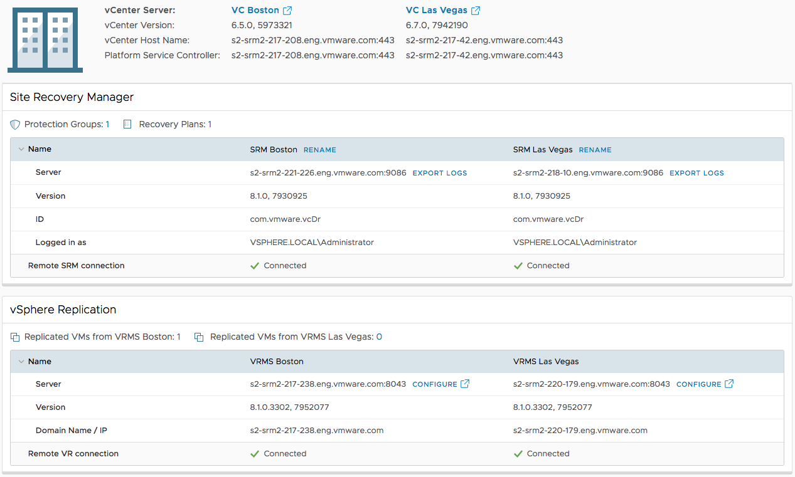
2.16 Deployment overview – Site Pairing

Slide 22
2.17 Deployment overview – Inventory mappings
There are multiple types of inventory mappings in Site Recovery Manager:
Resource mappings
Folder mappings
Network mappings

Slide 23
2.18 Deployment overview – Inventory mappings (continued)
Mappings provide default settings for recovered virtual machines:
A mapping can be configured between a network port group named “Prod-100” at the protected site and a network port group named “Prod-200” at the recovery site.
VMs connected to “Prod-100” at the protected site will, by default, automatically be connected to “Prod-200” at the recovery site. Networks to be used during testing can also be configured in the same area.

Slide 24
2.19 Deployment overview – Placeholder VMs and Datastores
For each protected virtual machine Site Recovery Manager creates a placeholder virtual machine at the recovery site.
Placeholder virtual machines are contained in a datastore and registered with the vCenter Server at the recovery site.
This datastore is called the “placeholder datastore”. Since placeholder virtual machines do not have virtual disks they consume a minimal amount of storage (1.25 MB/VM).

Slide 25
2.20 Deployment overview – Placeholder VMs and Datastores (continued)
The protected and recovery sites will each require a small datastore that is accessible by all hosts at that site. This placeholder datastore allows for failover as well as failback. Site Recovery Manager will automatically select the placeholder datastore if it isn't chosen by the administrator.
When utilizing Storage Policy-Based Protection Groups, placeholder datastores are not required and placeholder VMs are not created as they are not needed for this new type of protection group.

Slide 26
2.21 Protection Groups
Protection groups are a way of grouping virtual machines that will be recovered together. In many cases, a protection group will consist of the virtual machines that support a service or application such as email servers or all VMs related to a particular application.
Creating a protection group for each application or service has the benefit of selective testing. Having a protection group for each application enables non-disruptive, low-risk testing of individual applications allowing application owners to non-disruptively test disaster recovery plans as needed.

Slide 27
2.22 Protection Groups (continued)
A protection group contains virtual machines whose data has been replicated by array-based replication, Virtual Volumes or vSphere replication. Before a protection group can be created, replication must be configured.
A protection group cannot contain virtual machines replicated by more than one replication solution (e.g. same virtual machine protected by both vSphere replication and array-based replication) and, a virtual machine can only belong to a single protection group.

Slide 28
2.23 Recovery plans
Recovery Plans in Site Recovery Manager are like an automated run book, controlling all the steps in the recovery process.
The recovery plan is the level at which actions like failover, planned migration, testing and re-protect are conducted. A recovery plan contains one or more protection groups, and a protection group can be included in more than one recovery plan.
This provides for the flexibility to test or recover an application by itself and also test or recover a group of applications or the entire site.

Slide 29
2.24 Recovery plan – Priority Groups
There are five Priority Groups in Site Recovery Manager. The VMs in Priority Group one are recovered first, then the virtual machines in Priority Group two are recovered, and so on. All VMs in a priority group are started at the same time and the next priority group is started only after all virtual machines are booted up and responding.
The most important VMs with the lowest RTO are typically placed in the first priority group and less important VMs in subsequent priority groups. Another example is by application tier - database servers could be placed in priority group 2; application and middleware servers in priority group 3; client and web servers in priority group 4.

Slide 30
2.25 Recovery plan – Dependencies
Dependencies can be used when more granularity is needed for startup order. A Dependency requires that before a virtual machine can start, a specific other virtual machine must already be running.
For example, a VM named “acct02” can be configured to have a dependency on another VM named “acct01”. Site Recovery Manager will wait until “acct01” starts before powering on “acct02”.
VMware Tools heartbeats are used to validate when a virtual machine has started successfully.

Slide 31
2.26 Recovery plan – Shutdown and Startup Actions
Shutdown actions apply to the protected VMs at the protected site during the run of a recovery plan. Shutdown actions are not used during the test of a recovery plan.
By default, SRM will issue a guest OS shutdown, which requires VMware Tools and there is a time limit of 5 minutes. The time limit can be modified. If the guest OS shutdown fails and the time limit is reached, the VM is powered off.

Slide 32
2.27 Recovery plan – Shutdown and Startup Actions (continued)
Shutting VMs down quiesces the guest OS and applications before the final storage synchronization occurs, as well as avoiding the potential conflict of having VMs with duplicate network configurations on the same network.
A startup action applies to a virtual machine that is recovered by SRM. Powering on a VM after it is recovered is the default setting. In some cases, it might be desirable to recover a virtual machine, but leave it powered off. Startup actions are applied when a recovery plan is tested or run.

Slide 33
2.28 Recovery plan – Pre and Post Power On Steps
SRM can run a command from the SRM server at the recovery site before and after powering on a VM. A common use case is calling a script to perform actions such as making changes to DNS and modifying application settings on a physical server.
Running a script inside of a VM is also supported as a post power on step. SRM can also display a visual prompt as a pre or post power on step.

Slide 34
2.29 Recovery plan – IP Customization
The most modified VM recovery property is IP customization. Most organizations have different IP address ranges at the protected and recovery sites.
When a VM is failed over, SRM can automatically change the network configuration (IP address, default gateway, etc.) of the virtual NIC(s) in the VM. This functionality is available in both failover and failback operations.
There are multiple IP customization modes in SRM. For example, it is possible to create an IP customization rule that maps one range of IP addresses to another.

Slide 35
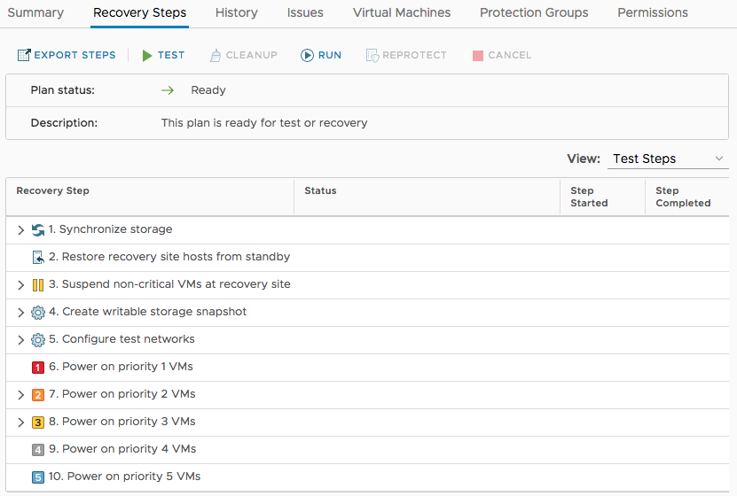
2.30 Recovery plan workflow – Testing
Test a recovery plan after creation to resolve any issues.

Slide 36
2.31 Recovery plan test considerations
SRM utilizes snapshots - either array snapshots (or clones) with array replication or VM snapshots with vSphere Replication - as part of the recovery plan test process.
This allows powering on and modifying VMs recovered as part of the test while replication continues to avoid RPO violations.
VM owners can log into their recovered VMs to verify functionality. SRM supports recovery plan testing periods of varying lengths - from a few minutes to several days. Longer tests tend to consume more storage capacity at the recovery site. due to the nature of snapshot growth.

Slide 37
2.32 Recovery plan workflow - cleanup
When testing is complete, a recovery plan must be “cleaned up”. This operation powers off VMs and removes snapshots associated with the test.
Once the cleanup workflow is finished, the recovery plan is ready for testing or running.
Running a recovery plan differs from testing a recovery plan. Testing a recovery plan does not disrupt virtual machines at the protected site.

Slide 38
2.33 Running a recovery plan
When running a recovery plan, SRM will attempt to shut down VMs at the protected site, or cross-vCenter vMotion them, if conducting a planned migration and utilizing stretched storage, before the recovery process begins at the recovery site.
Recovery plans are run when a disaster has occurred, and failover is required or when a planned migration is desired.
After a recovery type is selected, the operator must confirm a checkbox as an additional safety measure. The idea behind this checkbox is to make sure the operator knows that he or she is running (not testing) a recovery plan.

Slide 39
2.34 Running a recovery plan (continued)
SRM will attempt to replicate recent changes from the protected site to the recovery site. It is assumed that for a planned migration, no loss of data, is the priority. If utilizing stretched storage, when conducting a planned migration, compatible VMs will be relocated utilizing cross-vCenter vMotion.
A planned migration will be canceled if errors in the workflow are encountered. For disaster recovery, the priority is recovering workloads as quickly as possible after disaster strikes. A disaster recovery workflow will continue even if errors occur. The default selection is a planned migration.

Slide 40
2.35 Running a recovery plan (continued)
The first step when running a recovery plan is an attempt to synchronize storage. Then, protected VMs at the protected site are shut down. This quiesces the VMs and commits any final changes to disk as the VMs complete the shutdown process. Storage is synchronized again to replicate any changes made during the shutdown of the virtual machines. Replication is performed twice to minimize downtime and data loss.
When running a recovery plan in planned migration mode and utilizing stretched storage, VMs that are capable of being vMotioned to the second site will be migrated first; then the plan will proceed as above. With disaster recovery, SRM will still attempt to sync storage but will proceed after error.

Slide 41
2.36 Re-protect and failback
SRM features the ability to not only fail over VM workloads, but also fail them back to their original site. This assumes that the original protected site is operational. An example of this is a disaster avoidance situation.
A recovery plan cannot be immediately failed back from the recovery site to the original protected site. The recovery plan must first undergo a re-protect workflow. This operation involves reversing replication and setting up the recovery plan to run in the opposite direction.

Slide 42
2.37 History reports
When workflows such as a recovery plan test and cleanup are performed in SRM, history reports are automatically generated. These reports document items such as the workflow name, execution times, successful operations, failures, and error messages.
History reports are useful for a number of reasons including internal auditing, proof of disaster recovery protection for regulatory requirements, and troubleshooting. Reports can be exported to HTML, XML, CSV, or a Microsoft Excel or Word document. There are summary, detailed and VM reports.

Slide 43
3.1 Architectural Overview for v8.4
Site Recovery Manager 8.4 is deployed in a paired configuration, for example, a protected site and a recovery site.
The Site Recovery Manager 8.4 software is deployed as an appliance at both sites.
It supports multiple versions of vCenter at either site.
There must be one or more vSphere hosts running version 6.5 or higher at each site.
See the Compatibility Matrixes for Site Recovery Manager 8.4 for specific details

Slide 44
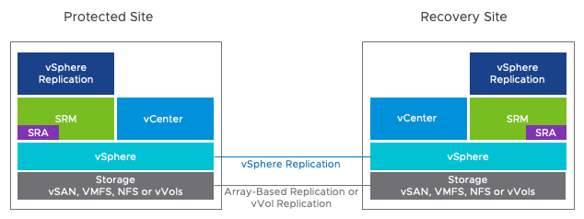
3.2 Architectural Overview for v8.4
Site Recovery Manager utilizes either vSphere Replication, array-based replication, Virtual Volume (vVols) replication, or stretched storage for transferring data between sites.

Slide 45
3.3 SRM high level storage considerations
Array-based replication and stretched storage must be licensed and configured and the appropriate storage replication adaptor must be installed on the Site Recovery Manager server at each site.
Virtual Volume (vVols) replication must be licensed and configured, however, there is no requirement for a storage replication adaptor when using vVols.
For vSphere Replication, the vSphere Replication virtual appliance must be deployed and the virtual machines to be protected by Site Recovery Manager must be configured for replication.

Slide 46
3.3 SRM stretched storage considerations
SRM supports using stretched storage, which allows customers to achieve what was previously only possible with vSphere Metro Storage Clusters:
Zero-downtime disaster avoidance
Planned maintenance downtime
To fully utilize stretched storage and the vMotion of protected virtual machines, stretched layer two network connectivity between sites must be in place as it isn’t possible to non-disruptively change the IP address of a running virtual machine.

Slide 47
3.4 SRM Storage Replication Options
Site Recovery Manager offers a choice of replication technologies:
Array-based replication
vSphere Replication
Virtual Volumes replication
Storage Policy-Based
The same virtual machine cannot be protected by more than one replication type. The virtual machine must be configured for replication before or as part of being protected by Site Recovery Manager.

Slide 48
3.5 SRM Array Based Replication
When using array-based replication, one or more storage arrays at the protected site replicate data to peer array(s) at the recovery site.
A storage replication adaptor (SRA) is required for the specific array and replication solution to be used with SRM. SRAs are software components that are created and supported by the array replication vendors using guidelines from VMware.

Slide 49
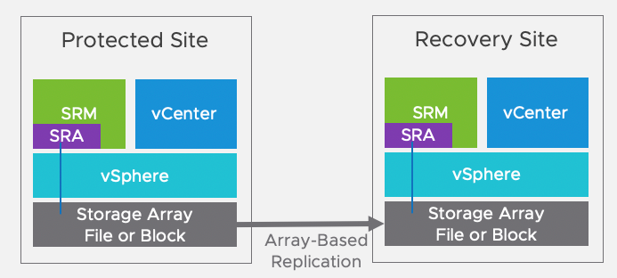
3.6 SRM Array Based Replication (continued)
The SRA is what SRM uses for communicating with the storage array. They are installed on the Site Recovery Manager servers at both sites and monitor and control array functions related to migrations, failovers, re-protections, failbacks, and tests.

Slide 50
3.7 SRM vSphere Replication
To use vSphere replication requires deployment and configuration of the vSphere Replication appliance, done independently of Site Recovery Manager.
vSphere replication is able to utilize any storage supported by vSphere so there is no requirement for storage arrays, similar or otherwise, at either site.
Documentation available at https://docs.vmware.com/en/vSphere-Replication/index.html

Slide 51
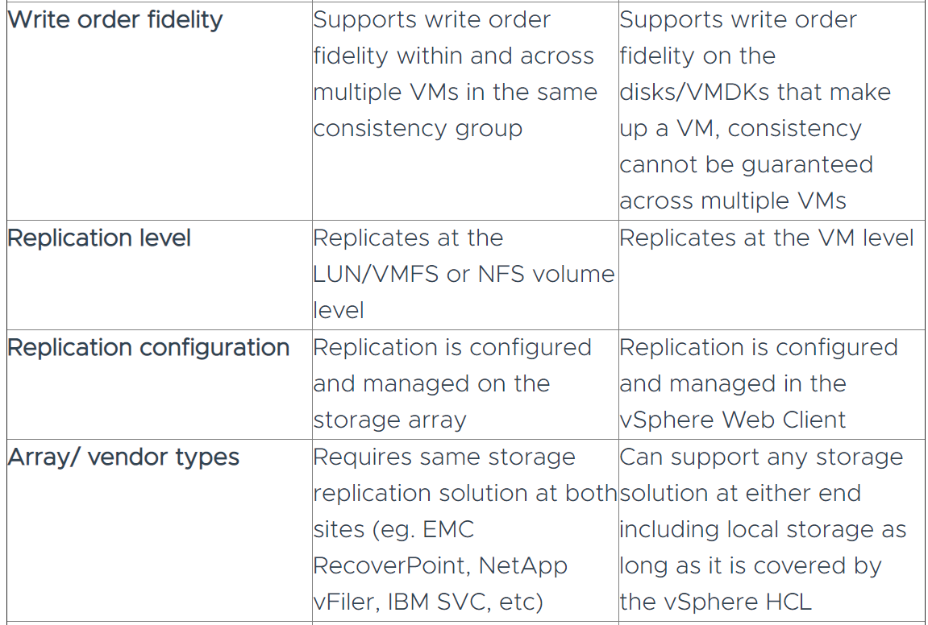
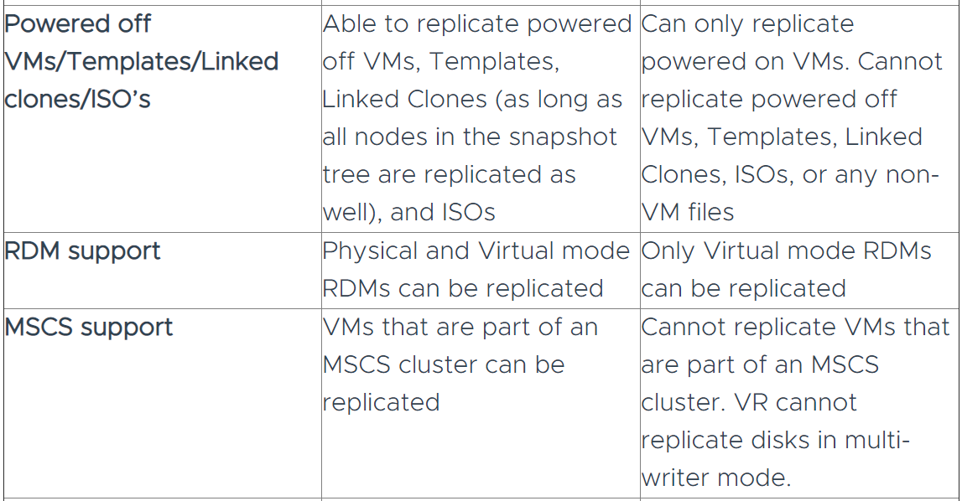
3.8 SRM vSphere Replication vs Array-Based
Array-Based Replication vs. vSphere Replication blog post by Cato Grace
https://core.vmware.com/resource/vsphere-replication-faq

Slide 52
3.9 SRM vVols Based Replication
vVols replication, debuted in v8.3, introduces the concept of Replication Groups (RG), which allow more efficient, accurate, and responsive recovery of virtual machines. A Replication Group is a group of replicated storage devices that provide atomic failover for an application. An RG is the minimum unit of failover and support a protection granularity as small as a single VM. Multiple VMs replicated together in an RG are maintained as a consistency group.
Replication Groups are created and managed by a storage administrator using the storage vendor’s tools or created on the fly, if the array supports "automatic" RG group selection. The VASA provider replaces the SRA.

Slide 53
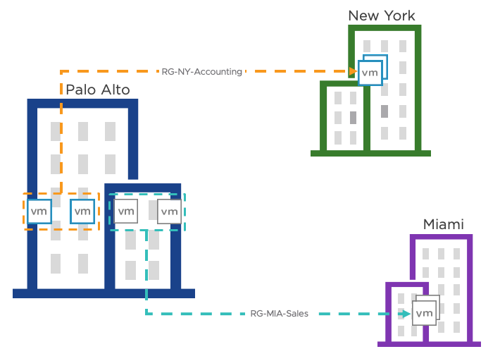
3.10 SRM vVols Based Replication (continued)
Replication Groups define the set of vVols that are maintained in write-order fidelity.
Writes are replicated on the destination site
in the exact same order they're generated
at the source site. This ensures at any time
the destination site represents at least a
crash-consistent version of the data
on the source site.

Slide 54
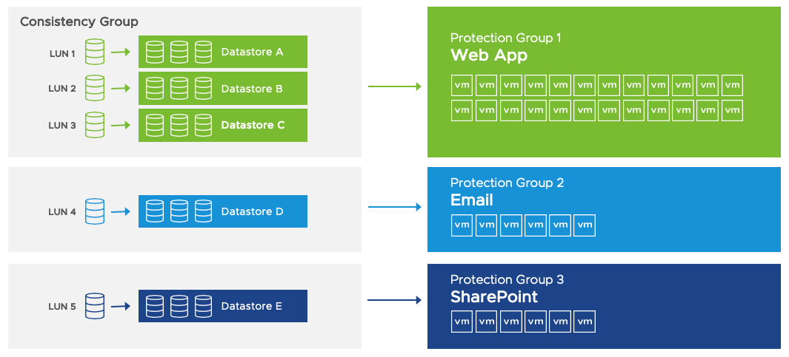
3.11 Array-based Protection Groups
The VMs included in array-based replication protection groups are determined by the storage where the virtual machines are located. All the virtual machines on a datastore have to be protected by Site Recovery Manager and they all have to belong to the same protection group.
It is not supported, advisable or
recommended to protect a subset
of virtual machines on a datastore.
Multiple LUNs can be configured
in a consistency group to ensure
write order consistency.

Slide 55
3.12 vVols-based Protection Groups
vVols v2.0 introduced the concepts of replication groups and fault domains, which SRM integration builds on. A fault domain roughly translates to a site or an array replication pair.
A vVol protection group can consist of one or more replication groups. All of a replicated VM disks must belong to the same replication group.
VMs are added to a virtual volume protection group by associating them with the storage policy that is configured for replication. This allows for the protection of virtual machines to be automated and policy-based.

Slide 56
3.13 vSphere Replication Protection Groups
For virtual machines protected by Site Recovery Manager using vSphere replication deciding what virtual machines are going to belong to what protection group is simple since virtual machines are replicated on an individual basis.
vSphere replication protection groups are not tied to storage type or configuration other than they cannot be located on array-based replication replicated storage.

Slide 57
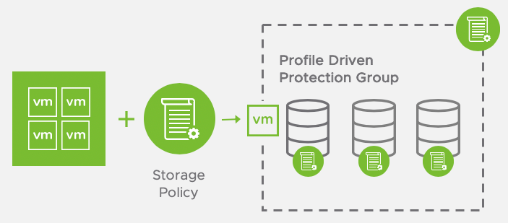
3.14 Storage Policy Based Protection Groups
Storage policy-based protection groups use vSphere storage profiles to identify protected datastores and VMs. They automate the process of protecting and unprotecting VMs and adding and removing datastores from protection groups.
Storage policy-based protection groups
utilize vSphere tags in combination
with vSphere storage policy-based
management to enable automated
policy-based protection for VMs.

Slide 58
3.15 SRM dependencies
Site Recovery Manager 8.4 and VMware vCenter Server, as well as the workloads they are protecting, require infrastructure services like DNS, NTP, DHCP, network routing, firewalling, and solutions like Active Directory.
These must be in place at both the protected and recovery sites.
SRM also depends on vCenter and a storage replication technology to be stable to be able to carry out recovery plans.

Slide 59
3.16 Heterogeneous Configurations
Some components in the SRM and vCenter Server installations must be identical on each site. But because the protected and recovery sites are often in different physical locations, some components on the protected site can be of a different type to their counterparts on the recovery site.
Site Recovery Manager is compatible with N-1 version of Site Recovery Manager on the paired site. For example, if the current version of Site Recovery Manager is 8.4, the supported versions for the paired site is 8.3 and later.

Slide 60
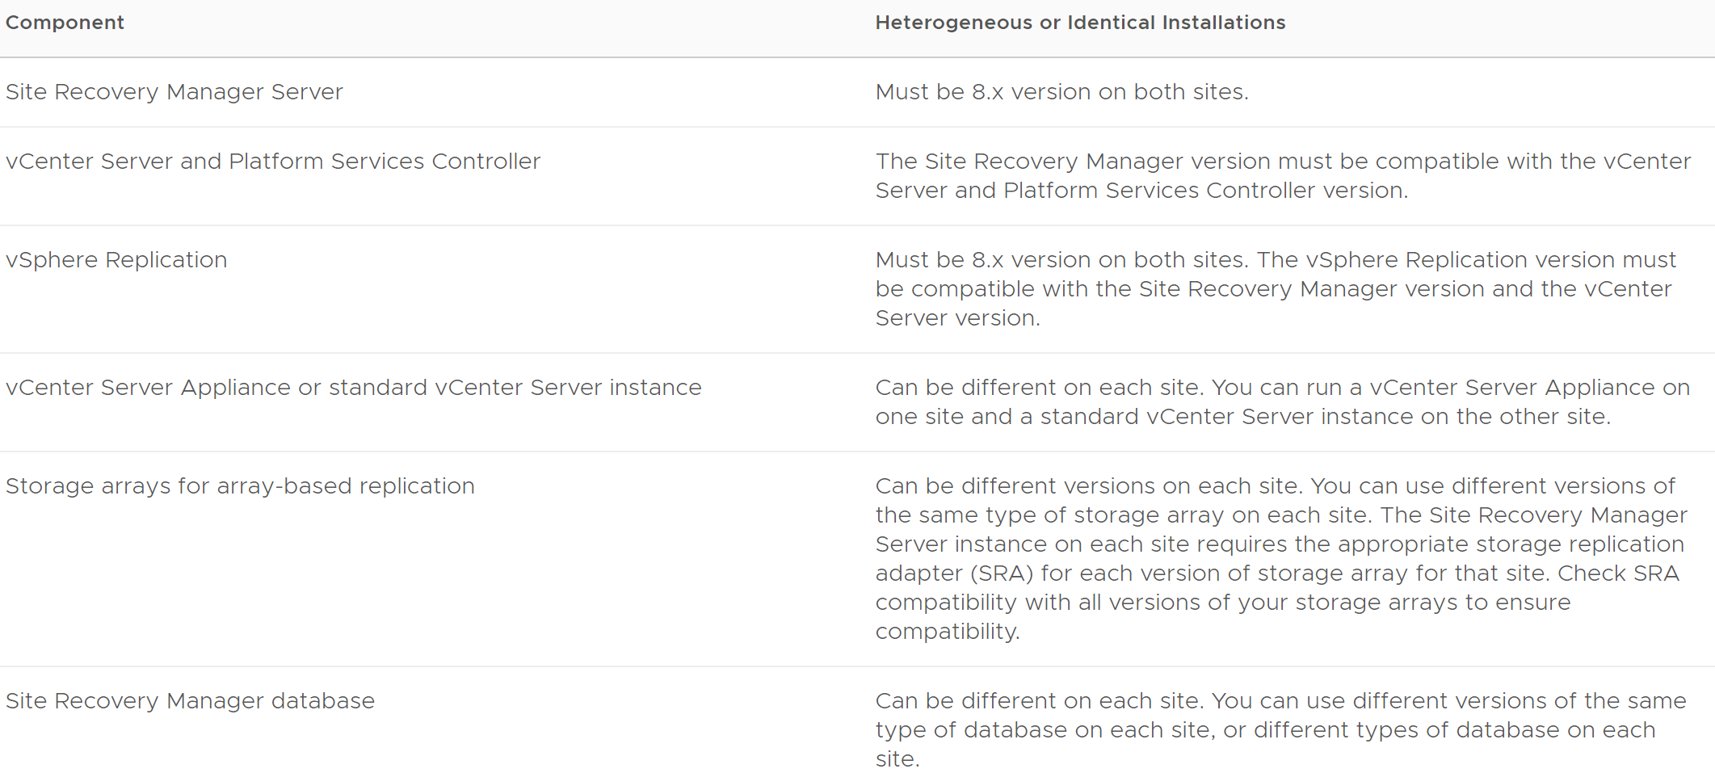
3.17 Heterogeneous Configurations table

Slide 61
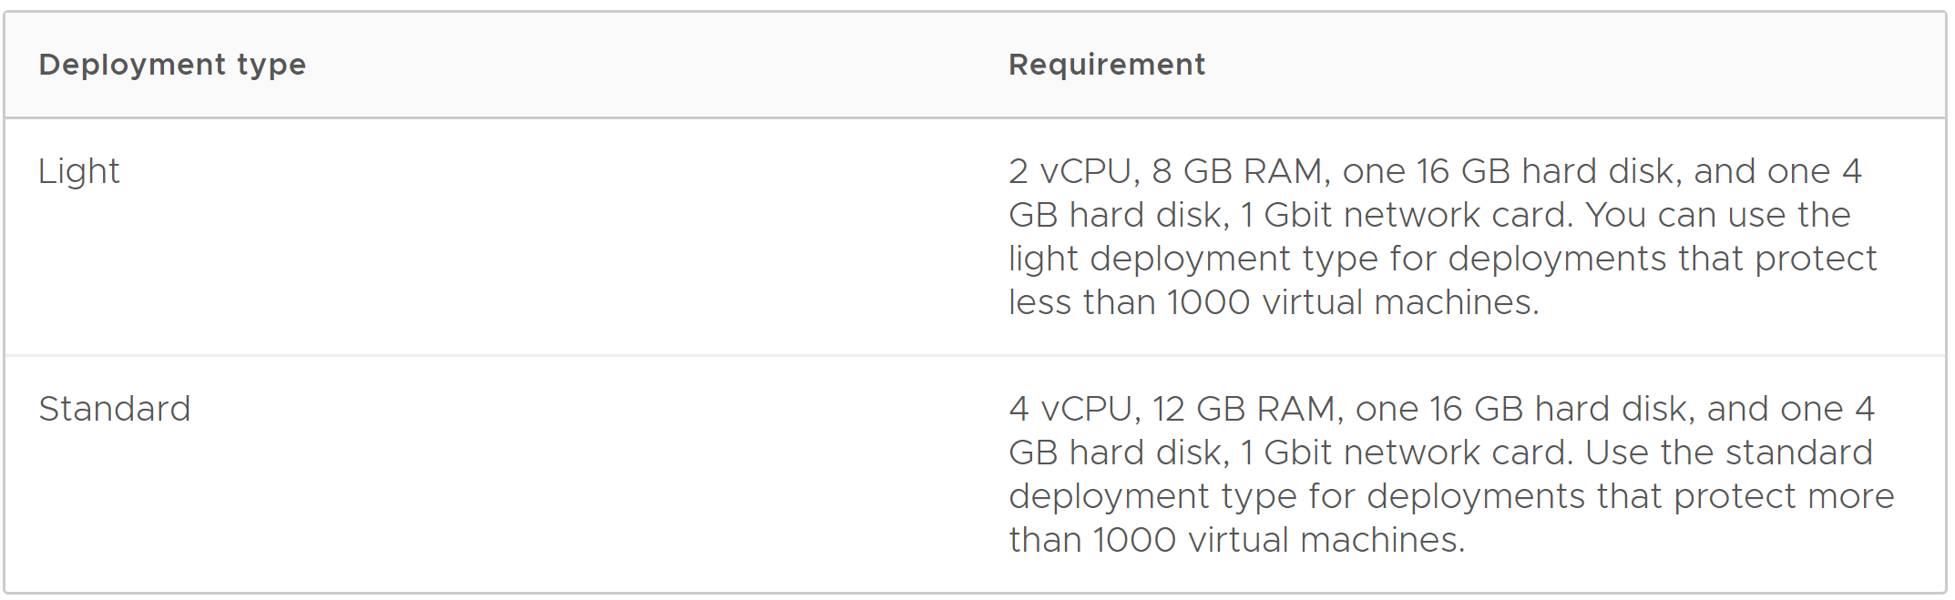
3.18 SRM sizing guidelines

Slide 62
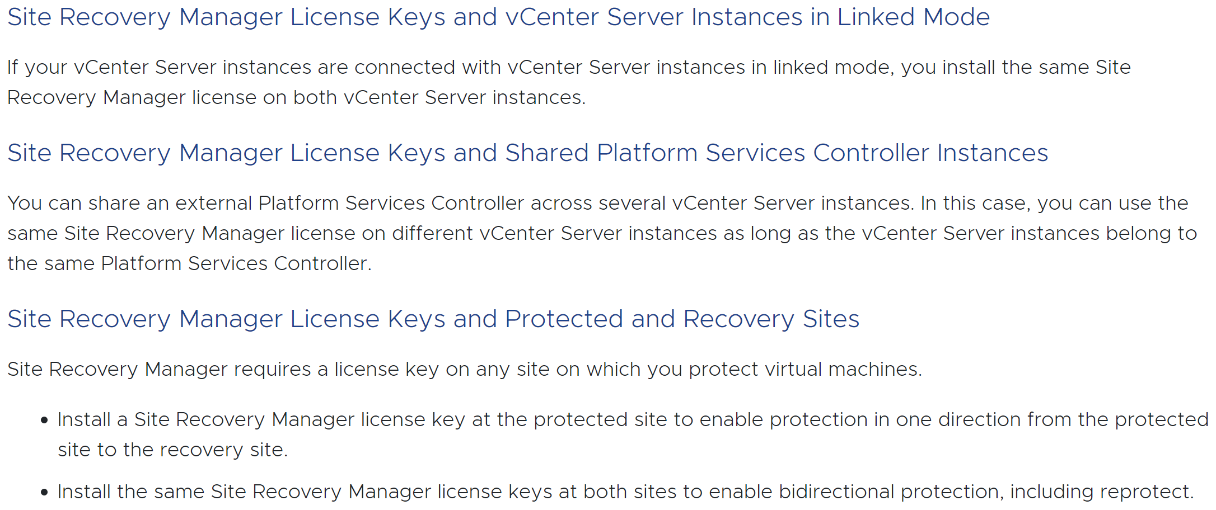
3.19 SRM licensing

Slide 63
3.20 SRM topologies
Site Recovery Manager can be used in a number of different failover scenarios depending on customer requirements, constraints and objectives.
Active-Passive
Active-Active
Bi-Directional
Multi-Site Shared Recovery
Multi-Site Shared Protection

Slide 64
3.21 SRM topology limits
Any of these and other multi-site topologies are supported provided these limits are taken into account:
Each virtual machine can only be protected in a single Site Recovery Manager pair
Site Recovery Manager doesn’t currently support the failover of the same virtual machine to different or multiple recovery sites

Slide 65
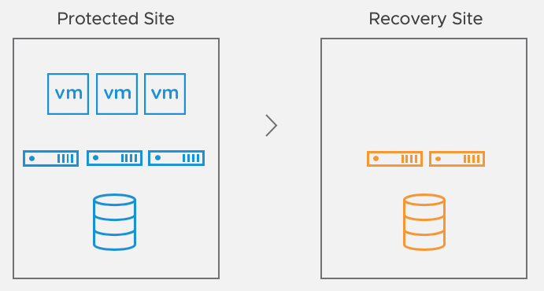
3.22 SRM topologies: Active-Passive
In the traditional active-passive scenario there is a production site running applications and services and a secondary or recovery site that is idle until needed for recovery.
This topology is common and though
it provides dedicated recovery
resources it means paying for a site,
servers and storage that aren’t
utilized much of the time.

Slide 66
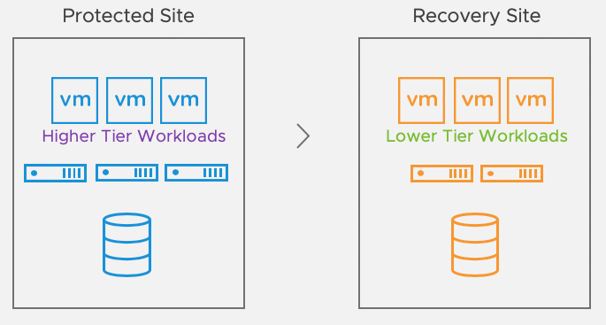
3.23 SRM topologies: Active-Active
Site Recovery Manager can be used in a configuration where low-priority workloads such as test and development run at the recovery site and are powered off as part of the recovery plan.
This allows for the utilization of
recovery site resources as well as
sufficient capacity for critical systems
in case of a disaster.

Slide 67
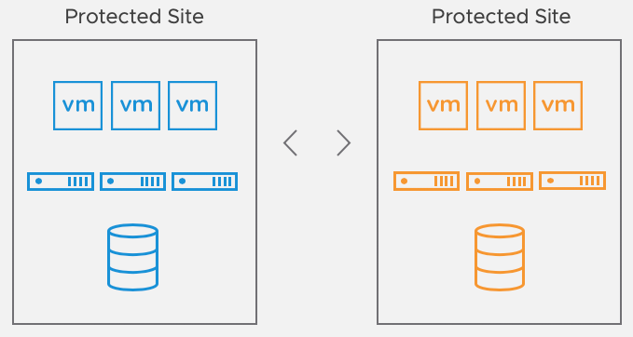
3.24 SRM topologies: Bi-Directional
In situations where production applications are operating at both sites, Site Recovery Manager supports protecting virtual machines in both directions (eg. virtual machines at Site A protected at site B and virtual machines at site B protected at site A).

Slide 68
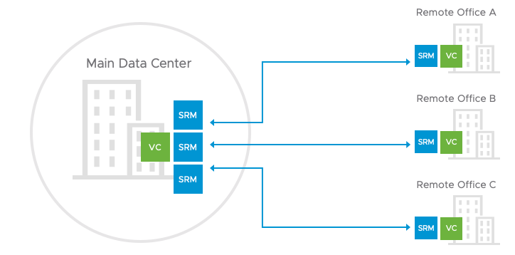
3.25 SRM topologies: Multi-site shared recovery
Multiple remote sites are protected by a single recovery site

Slide 69
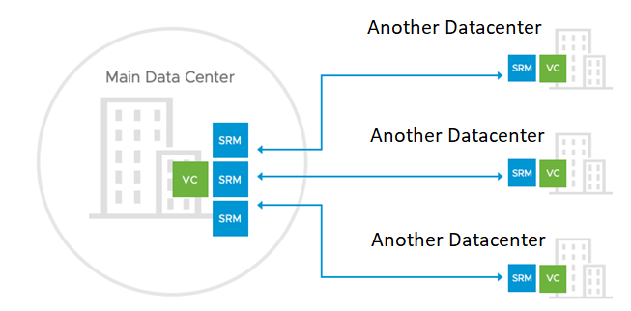
3.26 SRM topologies: Multi-site shared protection
A single site fails over some applications/virtual machines to one remote site and others to one or more additional remote sites

Slide 70
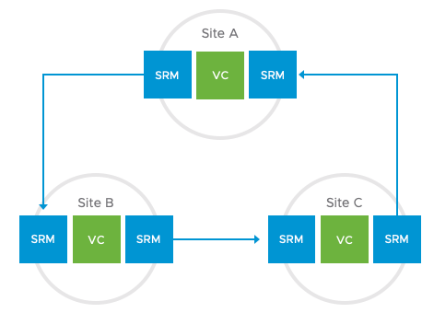
3.27 SRM topologies: Multi-site chained protections
For example, a three-site configuration where site A’s workloads are protected at site B, site B’s are protected at site C and site C’s are protected at site A.

Slide 71
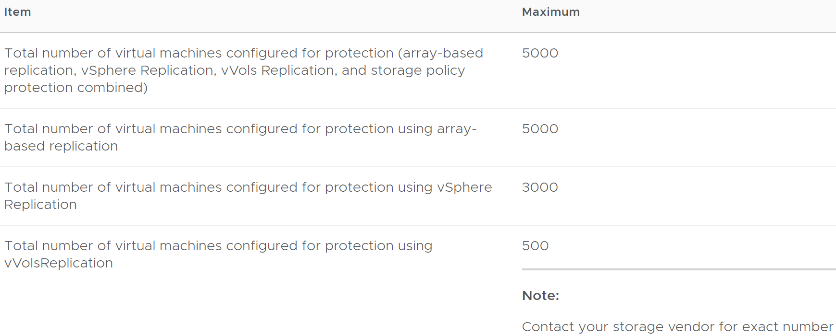
3.28 Protection Maximums for 8.4
See 8.4 announcement blog post for more details

Slide 72
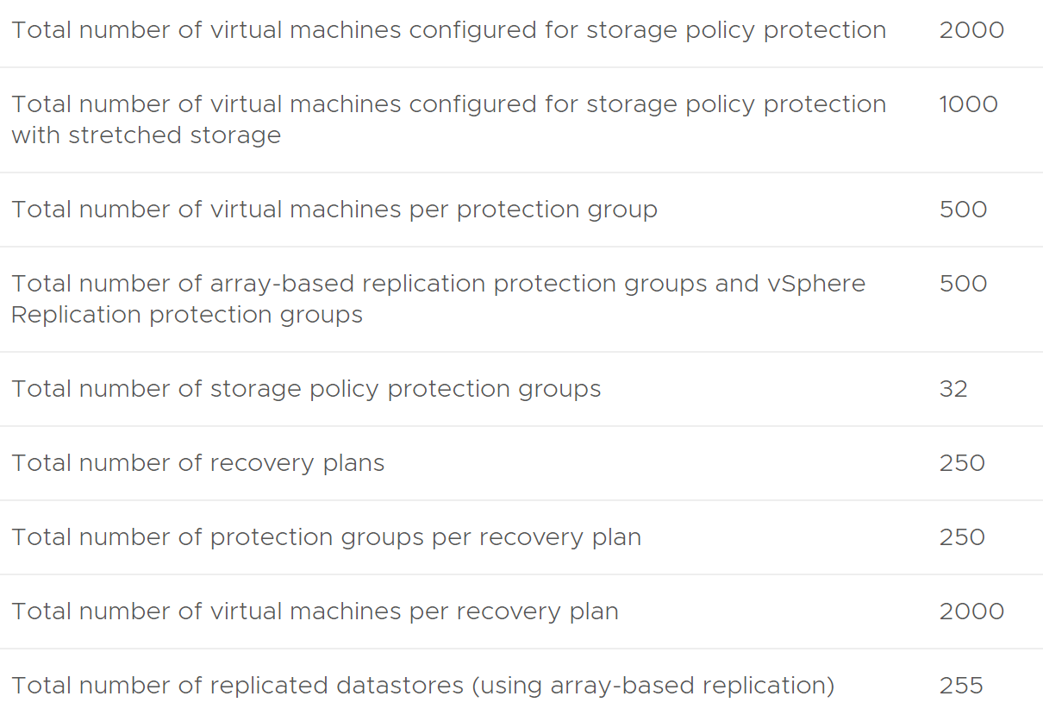
3.29 Protection Maximums for 8.4 (continued)

Slide 73
3.30 Protection Maximums for 8.4 (continued)
You can run array-based protection groups alongside vSphere Replication protection groups and storage policy protection groups in the same SRM server instance. The total number of protection groups cannot exceed 500 for all protection types combined.
The protection limit for array-based replication is 5,000 VMs. The protection limit for vSphere Replication is 3,000 VMs. However, the maximum number of virtual machines that you can protect by using a combination of array-based and vSphere Replication is still 5,000 virtual machines, and not 8,000.

Slide 74
3.31 Protection Maximums for 8.4 (continued)
If you establish bidirectional protection, in which site B serves as the recovery site for site A and at the same time site A serves as the recovery site for site B, limits apply across both sites, and not per site.
You can protect a different number of VMs on each site, but the total number of protected VMs across both sites cannot exceed the limits:
If you protect 3,000 VMs using array-based replication from site A to site B, you can use array-based replication to protect a maximum of 2,000 VMs from site B to site A.
If you are using array-based replication for bidirectional protection, you can protect a total of 5,000 VMs across both sites.

Slide 75
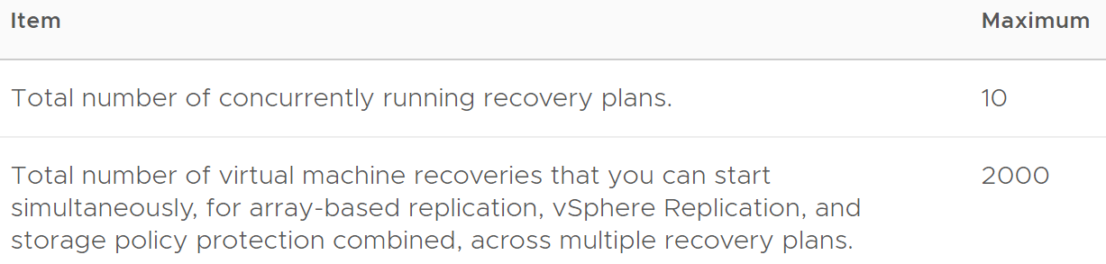
3.32 Recovery Maximums for 8.4
If you protect 5000 VMs with SRM, you can recover up to 2000 VMs in one recovery plan. After that plan has finished, you can run another recovery plan to recover another 2000 VMs. When the second plan has also completed, you can recover the remaining 1000 VMs.

Slide 76
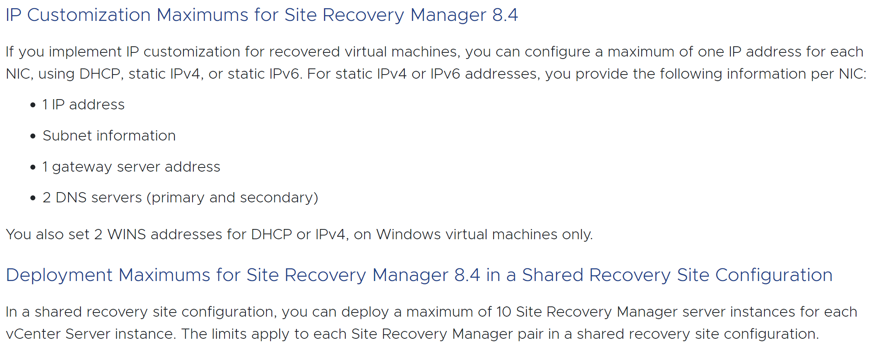
3.33 Other operational limits for 8.4

Slide 77
3.34 Network ports
The components that make up a Site Recovery Manager deployment, namely:
vCenter Server
Platform Services Controller, if external
vSphere Web Client
Site Recovery Manager Server
vSphere Replication appliance
vSphere Replication servers
ESXi hosts
All require different ports to be open. You must ensure that all the required network ports are open for Site Recovery Manager to function correctly.

Slide 78
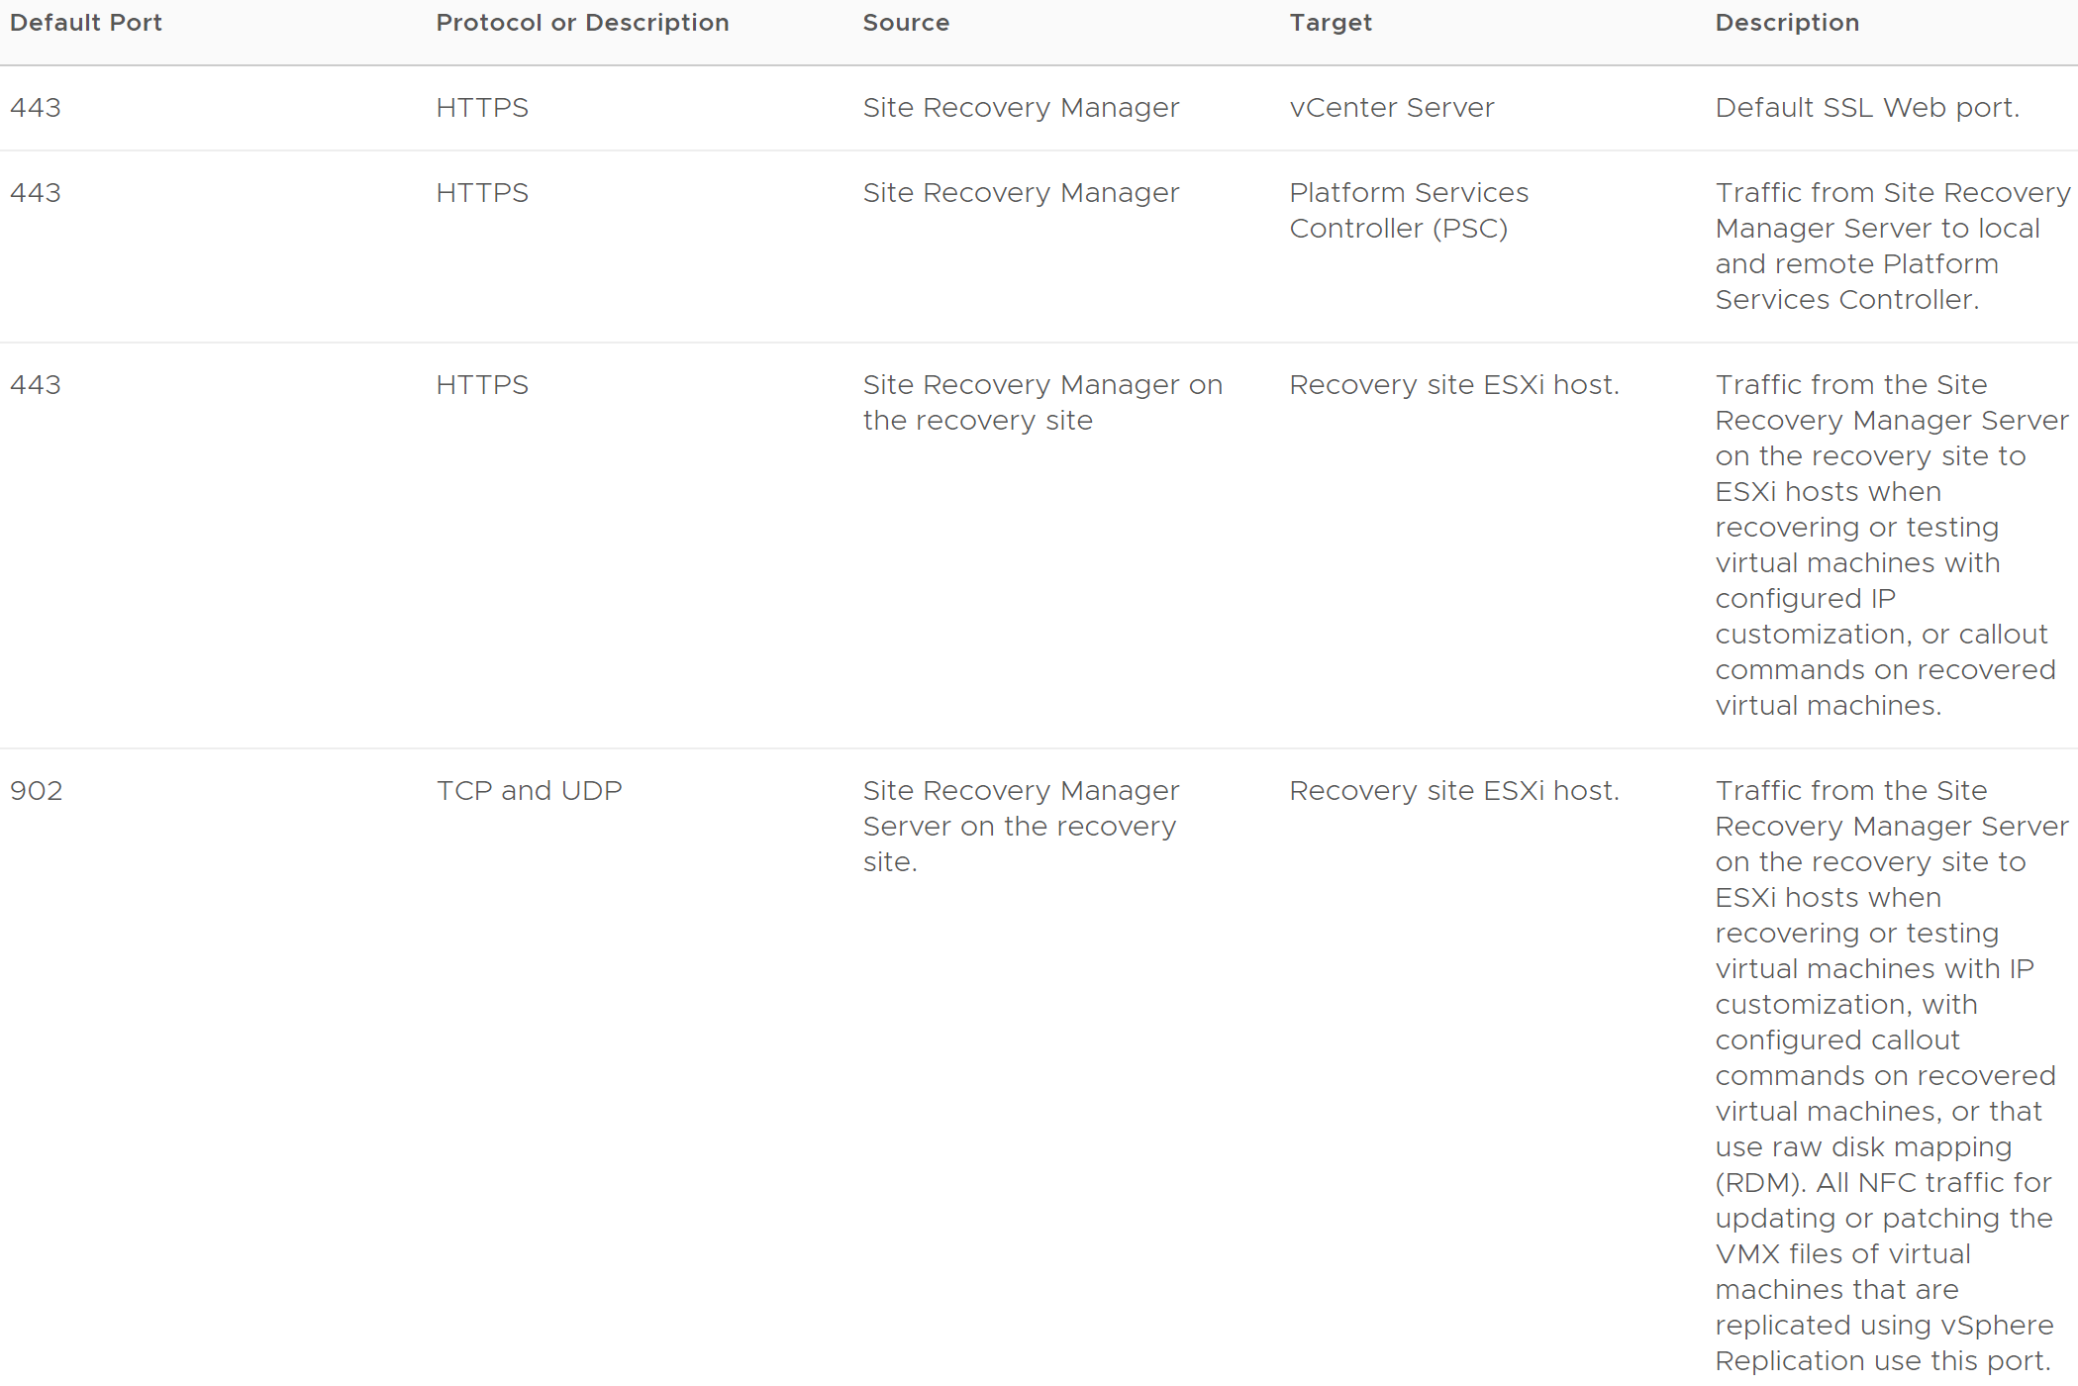
3.35 Network ports – vSphere infrastructure

Slide 79
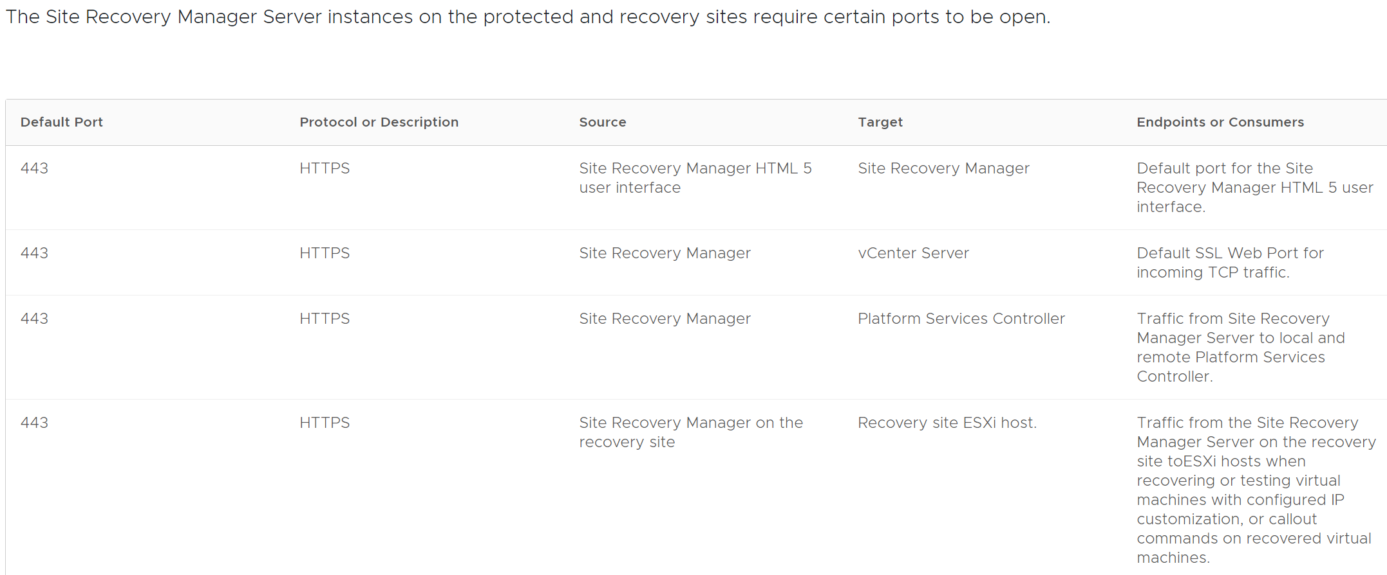
3.36 Network ports – SRM server

Slide 80
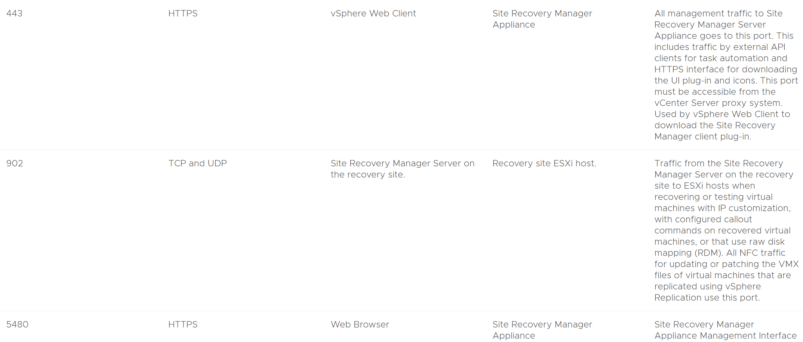
3.37 Network ports – SRM server (continued)

Slide 81
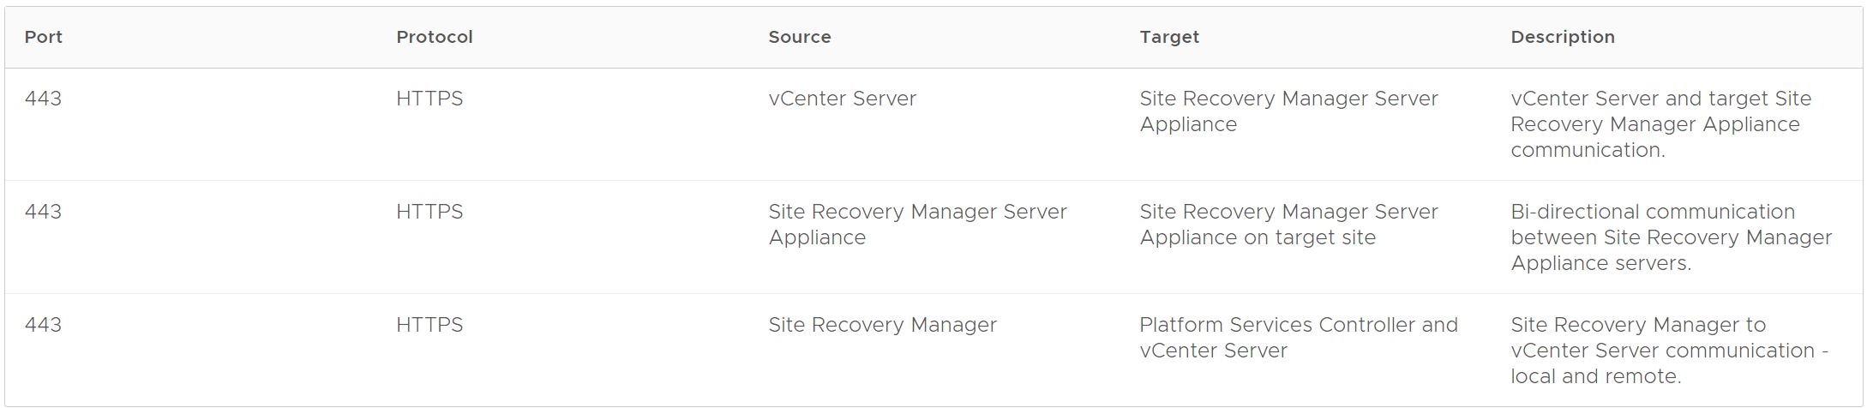
3.38 Network ports – SRM site pairing

Slide 82
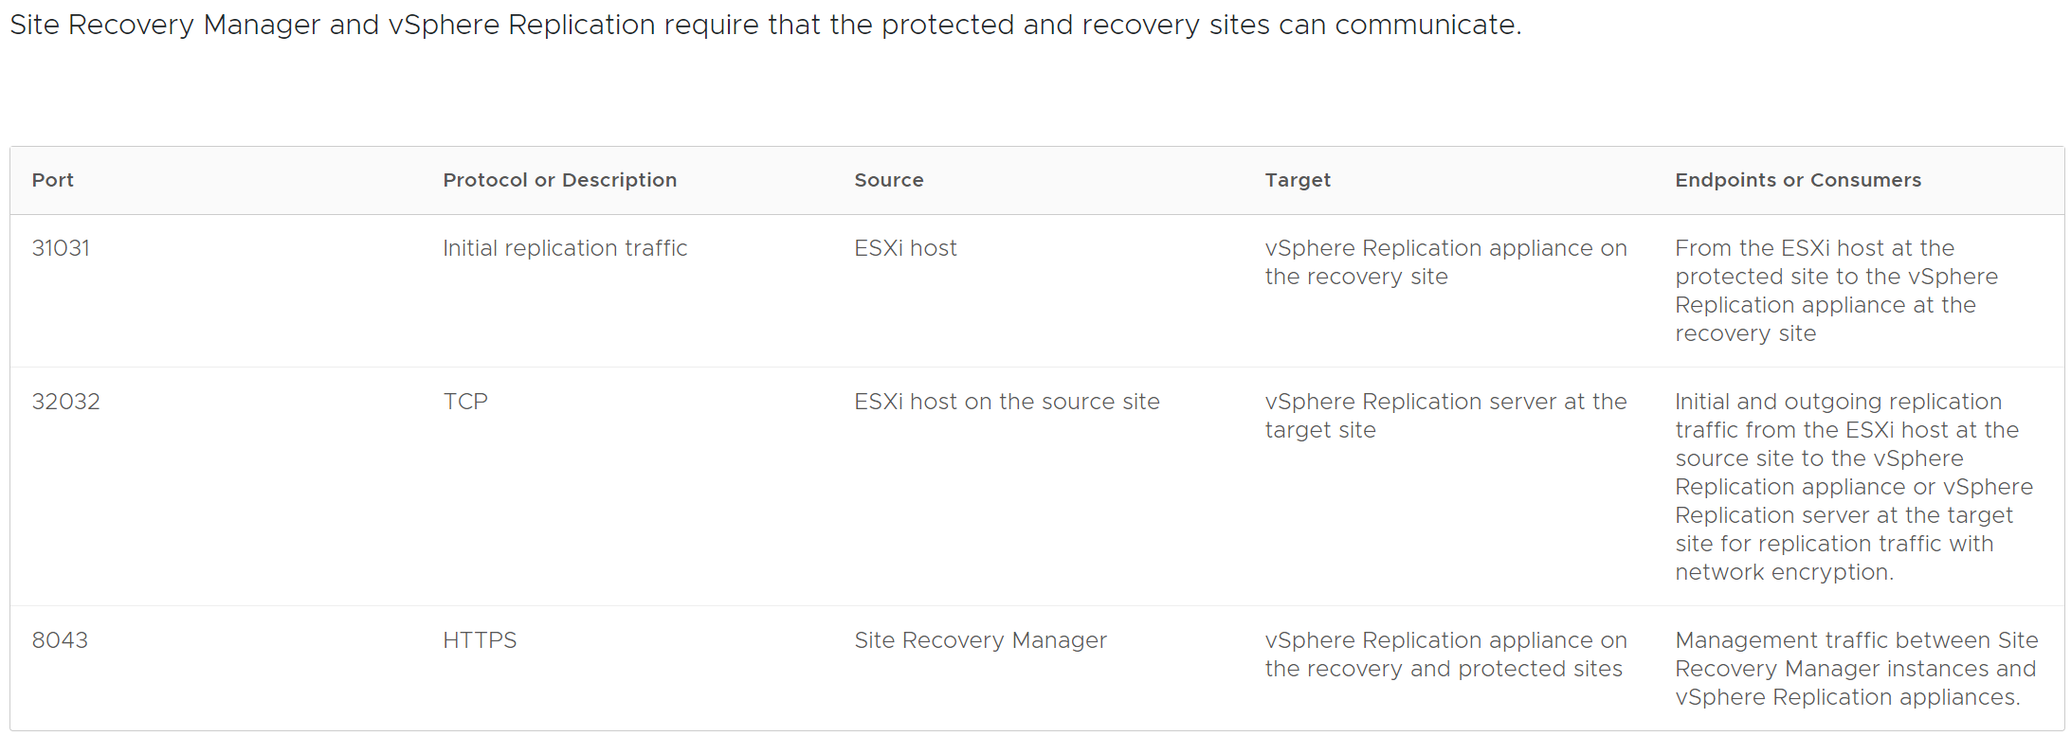
3.38 Network ports – SRM & vSphere Replication

Slide 83
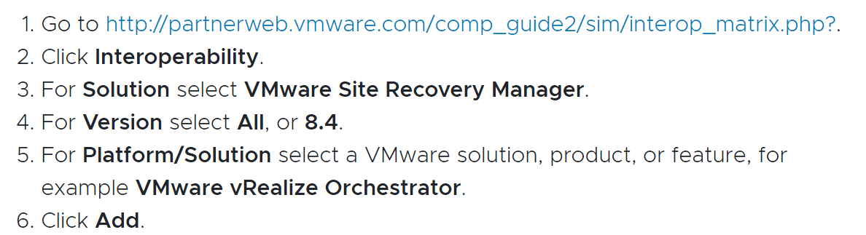
4.1 Fit with VMware and 3rd party solutions
For VMware products the best place to start is the compatibility matrix for your SRM version
https://docs.vmware.com/en/Site-Recovery-Manager/8.4/rn/srm-compat-matrix-8-4.html
It also shows how to check
with the Interoperability Matrix

Slide 84
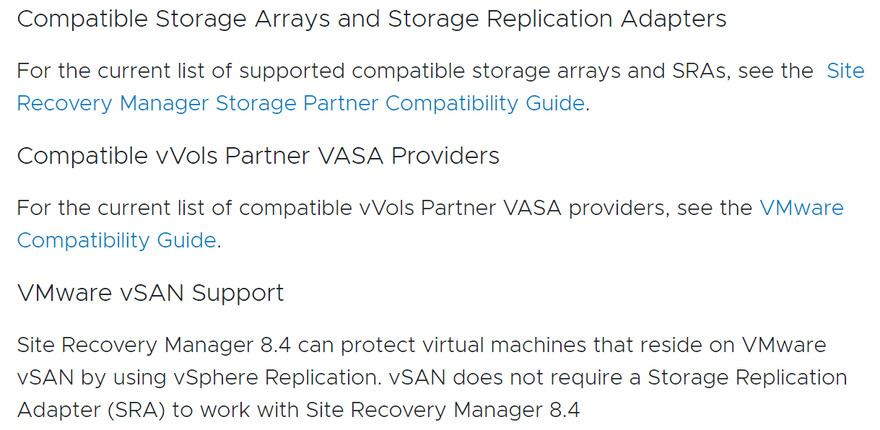
4.2 Fit with VMware and 3rd party solutions
Integration with Storage Arrays is an important aspect of vSphere when not using vSphere Replication.
Storage array and Storage Replication
Adapters (SRAs) or vVols are found
in the Compatibility Guide

Slide 85
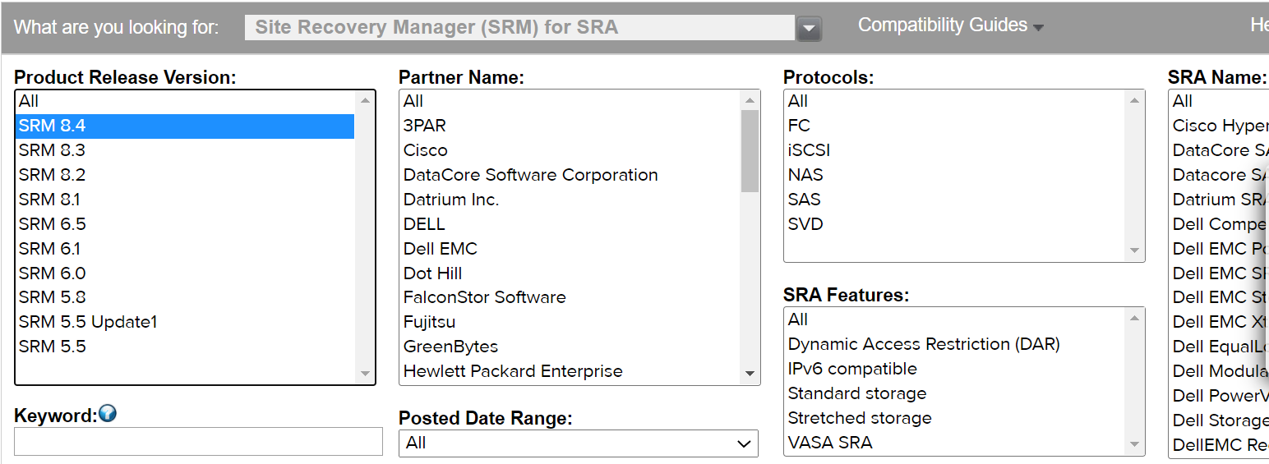
4.3 Fit with VMware and 3rd party solutions
Link for SRA search. 8.4 did not add big changes for SRAs https://www.vmware.com/resources/compatibility/search.php?deviceCategory=sra

Slide 86
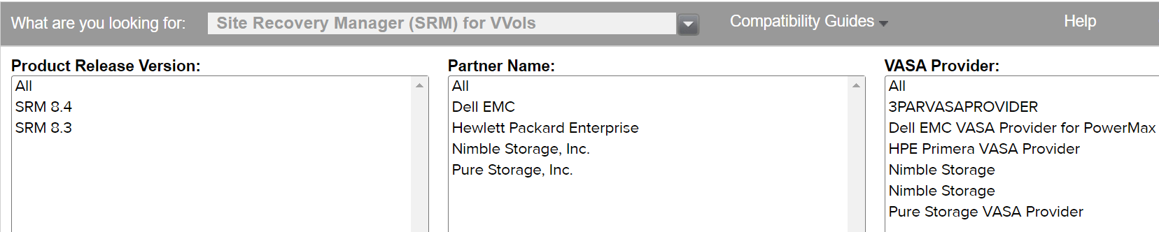
4.4 Fit with VMware and 3rd party solutions
Link for vVols search. 8.4 did not add big changes for SRAs compared to 8.3
https://www.vmware.com/resources/compatibility/search.php?deviceCategory=srmvvol

Slide 87
Additional links discussed live
HCX integrates with SRM https://docs.vmware.com/en/VMware-HCX/services/user-guide/GUID-B842696B-89EF-4183-9C73-B77157F56055.html
Advanced cross vCenter integrated in vSphere 7u1c https://blogs.vmware.com/vsphere/2020/12/advanced-cross-vcenter-server-migration-integrated-in-vsphere-7-u1c.html previously available as a fling https://flings.vmware.com/cross-vcenter-workload-migration-utility

Slide 88
The end!
This pptx is meant to give you a solid technical background
Next session we will explore real world scenarios and design solutions using SRM!

